Slide 1
0x406 – Buffer Overflows & Lab Instructions
ECED4406 – Computer Security
Dr. Colin O’Flynn
Dalhousie University.

Slide 2
More Resources on Buffer Overflow Attacks
Original article, “Smashing the Stack for Fun & Profit”:
https://inst.eecs.berkeley.edu/~cs161/fa08/papers/stack_smashing.pdf
Blended attack exploits also an early ref:
https://courses.cs.washington.edu/courses/cse484/14au/assignments/blended.attacks.pdf

Slide 3
What is a Buffer?
…you should know this by 4th year CE….

Slide 4
What is a Buffer Overflow?
Writing data beyond the expected end point
Typically means you may have:
Data corruption
Control flow changes
Crashes (most likely!)

Slide 5
Higher Address
Function Arguments
Saved Return Address
Saved Frame Pointer
Stack Frame
Local Variables
Function Arguments
Saved Return Address
Saved Frame Pointer
Stack Growth Direction
Local Variables
Stack Pointer
Lower Address

Slide 6

Function Setup
Function Arguments
Saved Return Address
Saved Frame Pointer
Local Variables
Stack Pointer

Slide 7
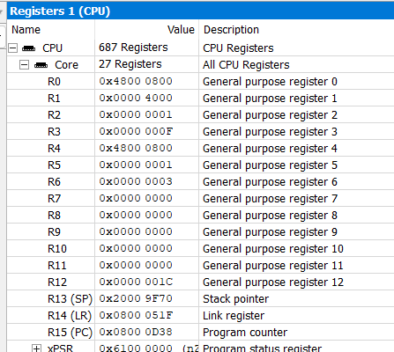
ARM Important Registers

Slide 8
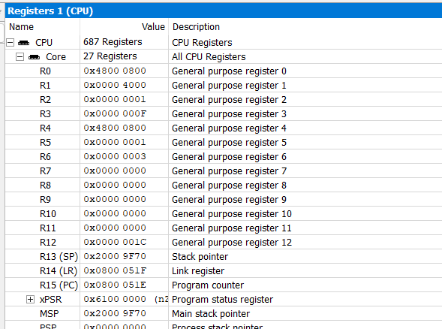
e.g., when returning from function Using “bx lr” instruction

Slide 9
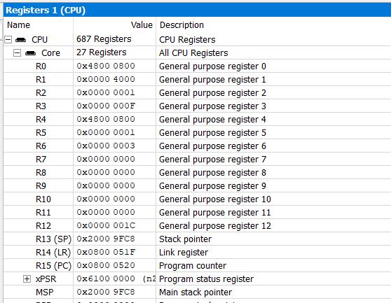


e.g., when returning from function Using “pop” instruction

Slide 10
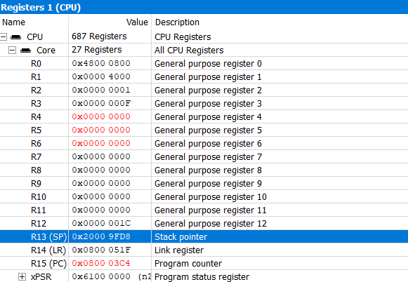

Slide 11
Code Flow Execution Attacks
If we could control the return value – could we not jump anywhere?
Saved Return Address
Saved Frame Pointer
Example: Jump to somewhere in the previous function stack (maybe a buffer we wrote code to?)
Local Variables
Function Arguments
Saved Return Address
Saved Frame Pointer

Slide 12
Shellcode In Buffer
Requires us to write shellcode into a buffer
Requires that we:
Know the location of the buffer.
Know something about the stack layout.
Can write & execute code from the buffer.

Slide 13
Return Oriented Programming (ROP)
We could also string together existing functions
Function Arguments
Saved Return Address
Saved Frame Pointer
Malicious Stack Frames (maybe hundreds or thousands!)
We write a code out of small existing functions we know the address of.
Function Arguments
Saved Return Address
Saved Frame Pointer

Slide 14
ROP vs. Shellcode
With ROP we are executing from valid addresses
Works even if memory is not executable

Slide 15
Protection Methods
GCC Stack Protector (You will explore in Assignment 2)
Write a known value to the stack
Check this value is the same before returning from the function

Slide 16
Protection Methods: Continued
Memory-Safe Languages, e.g.:
Rust
Python
..many more
Buffer Data
Buffer Metadata

Slide 17
Protection Methods: Continued
Non-Executable Code Sections
Buffer Data
Code Data

Slide 18
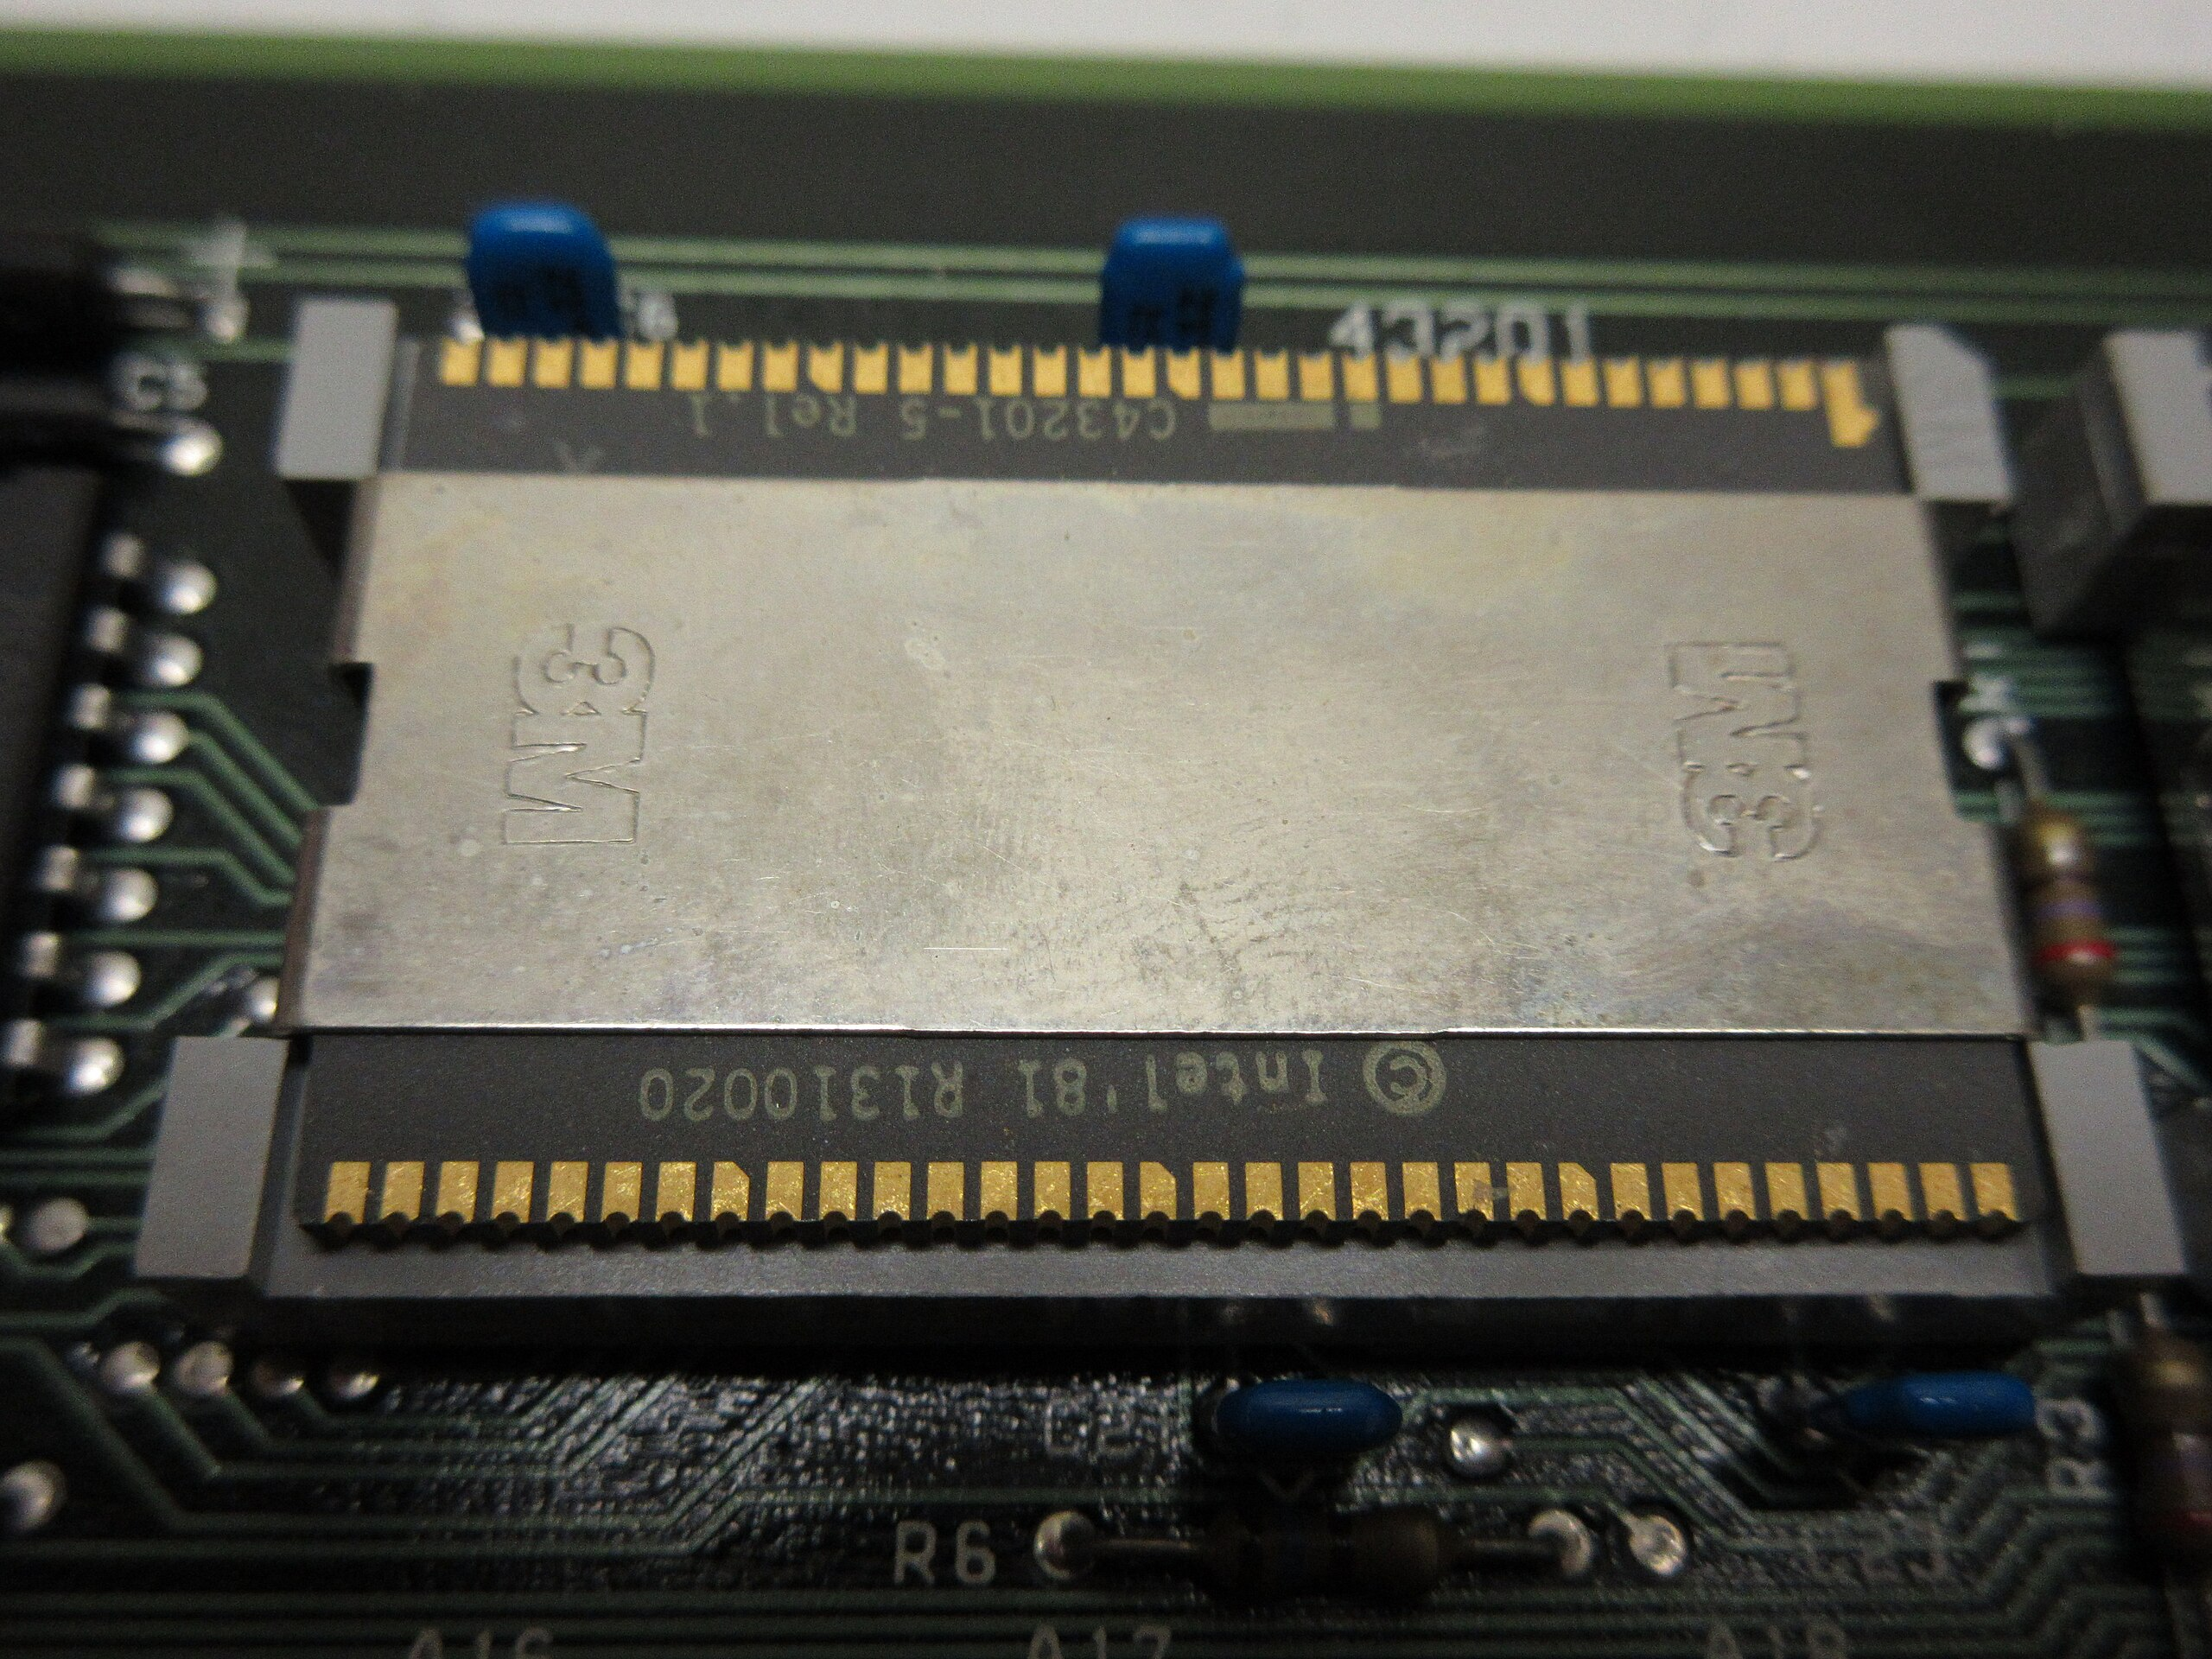
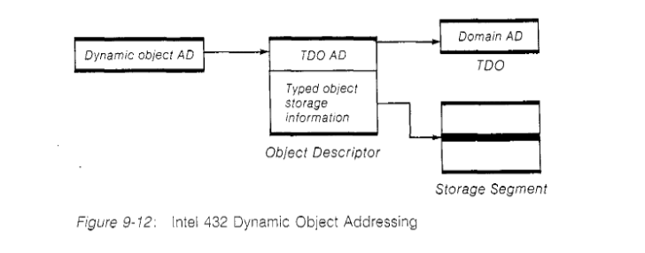
Slightly Insane Protective Methods
https://en.wikipedia.org/wiki/Intel_iAPX_432
https://homes.cs.washington.edu/~levy/capabook/Chapter9.pdf

Slide 19
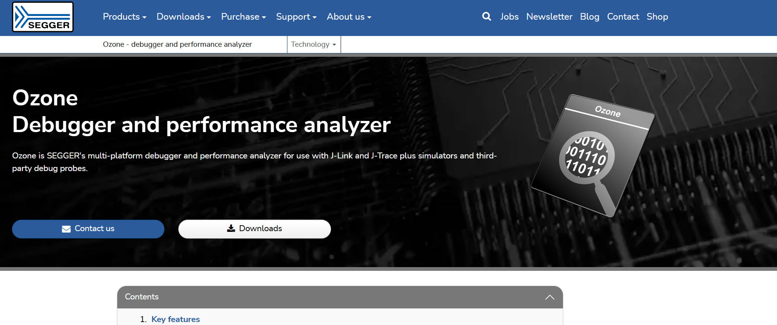

Ozone Introduction
This Ozone when googling it

Slide 20
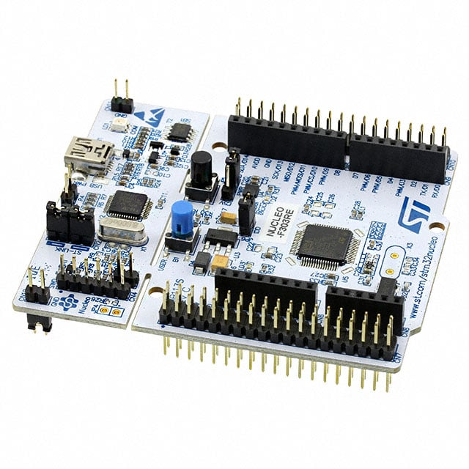
STM32 Nucleo Board in “J-Link Mode”
Debugger
Target

Slide 21
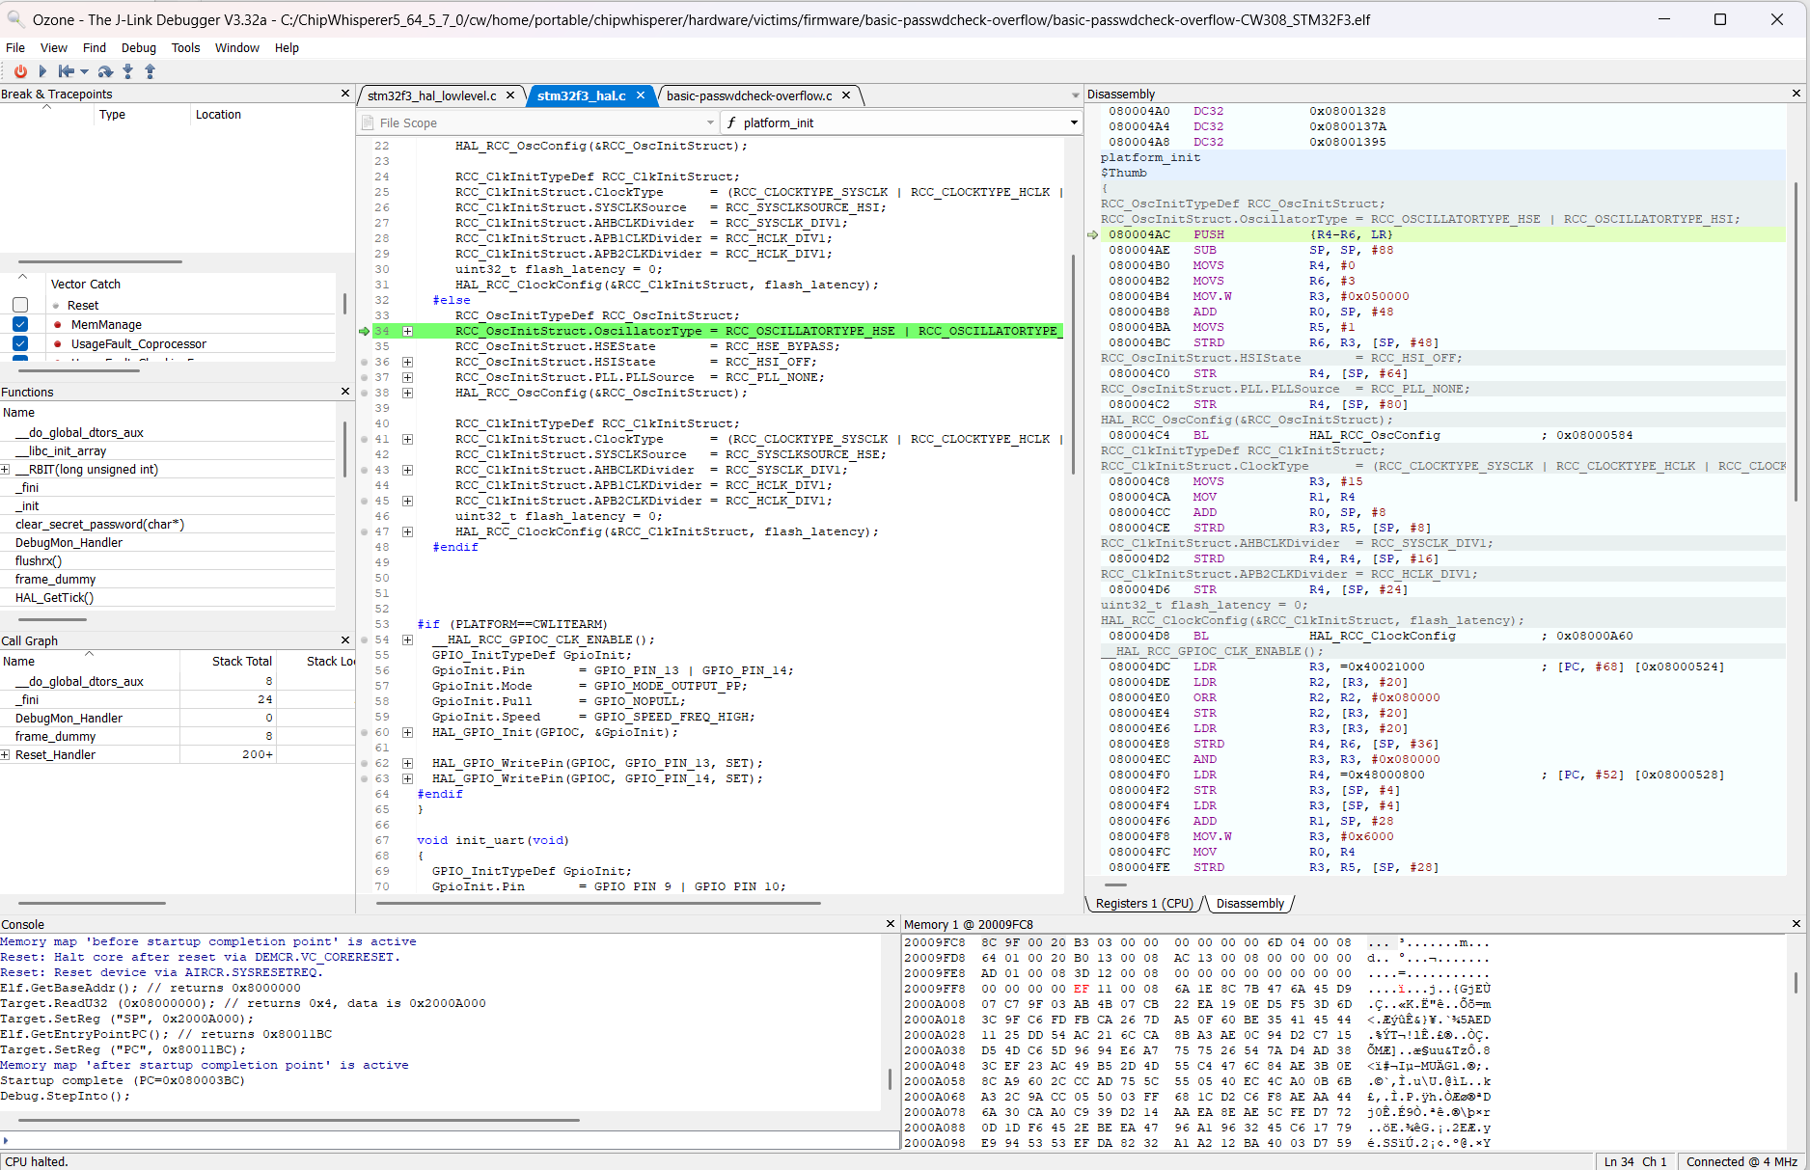
Ozone with Debug Symbols

Slide 22
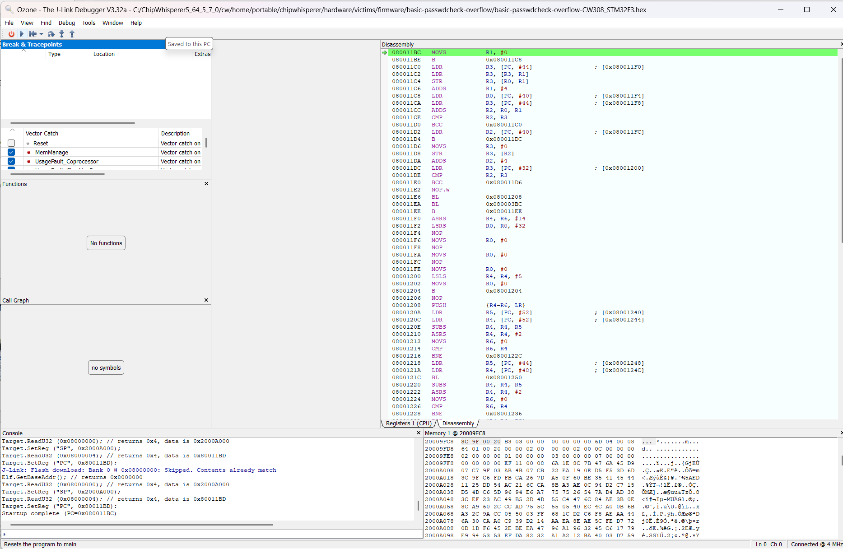
What you will see

Slide 23

Brief Intro to Ozone: Stepping
Go (Run)
Or
Pause (when running)
Reset
Step
Over
Step
Into
Step
Out

Slide 24
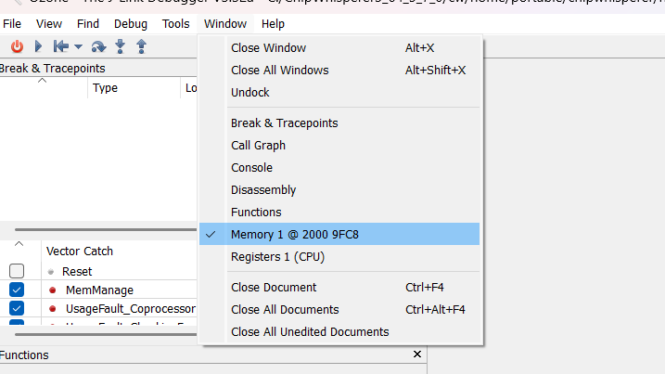
Brief Intro to Ozone: Memory

Slide 25
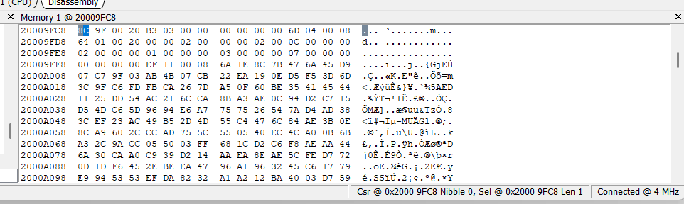
Brief Intro to Ozone: Memory
You can go to any memory address, even invalid ones. If you see “-” you might be on invalid memory.
Memory is NOT updated when running – need to pause the program to do that.

Slide 26
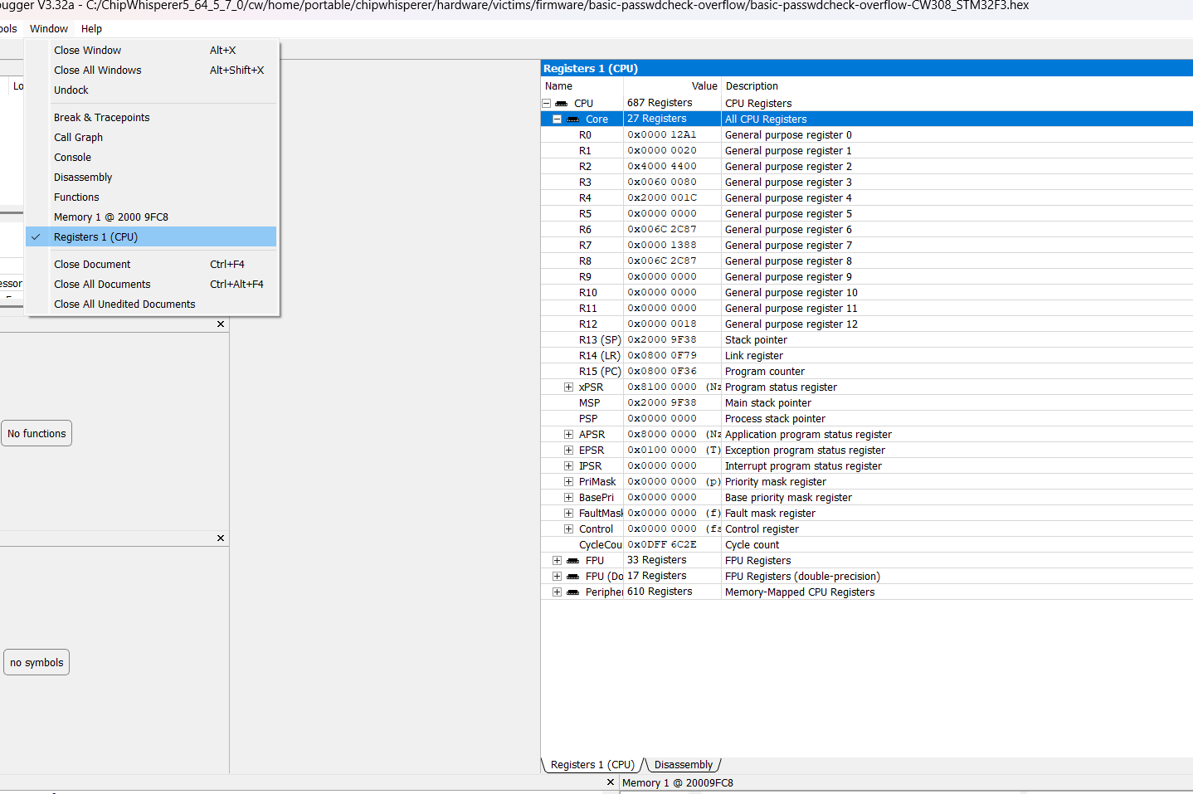
Registers

Slide 27
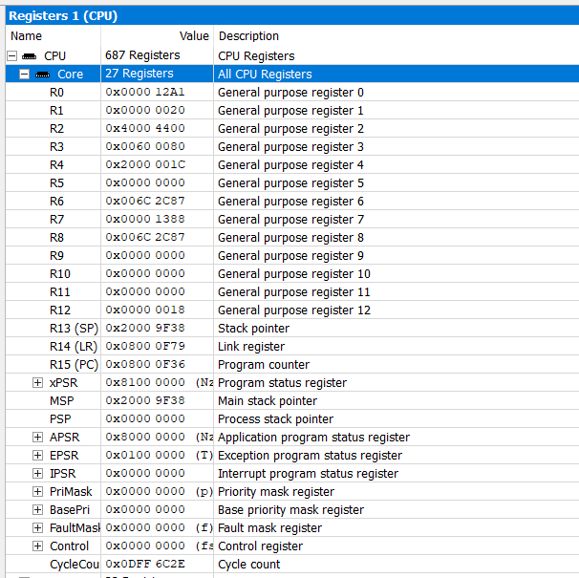
Registers
Be sure to expand (+) these so you see “Core” registers.

Slide 28
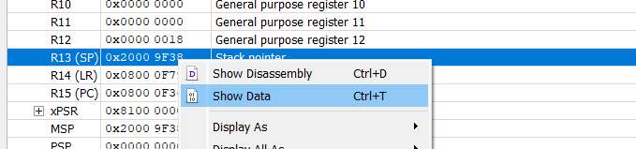
Registers & Memory Jumping
Show code
Show data (useful for stack!)

Slide 29
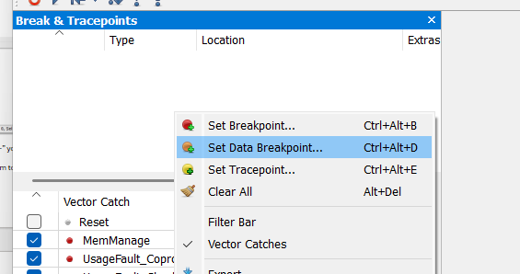
Breakpoints (Data & Code)
Right click
Example: Breakpoint on UART2 peripheral setup

Slide 30
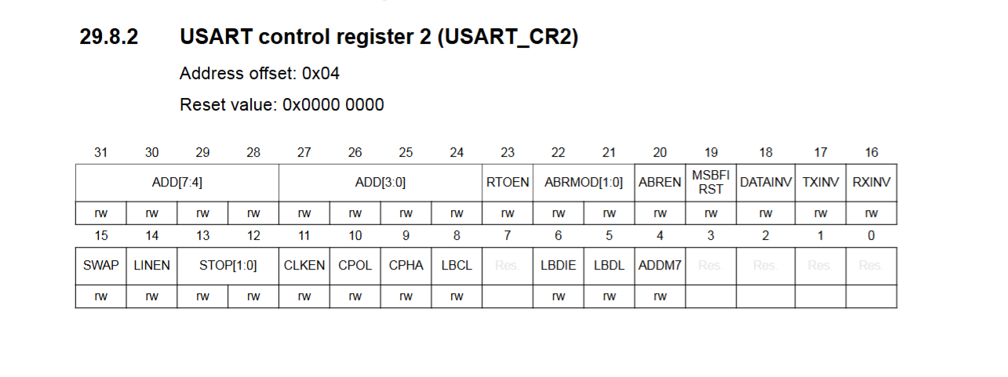
Breakpoints (Data & Code)

Slide 31
Breakpoints (Data & Code)
0x40004400 + 0x04 = 0x40004404

Slide 32
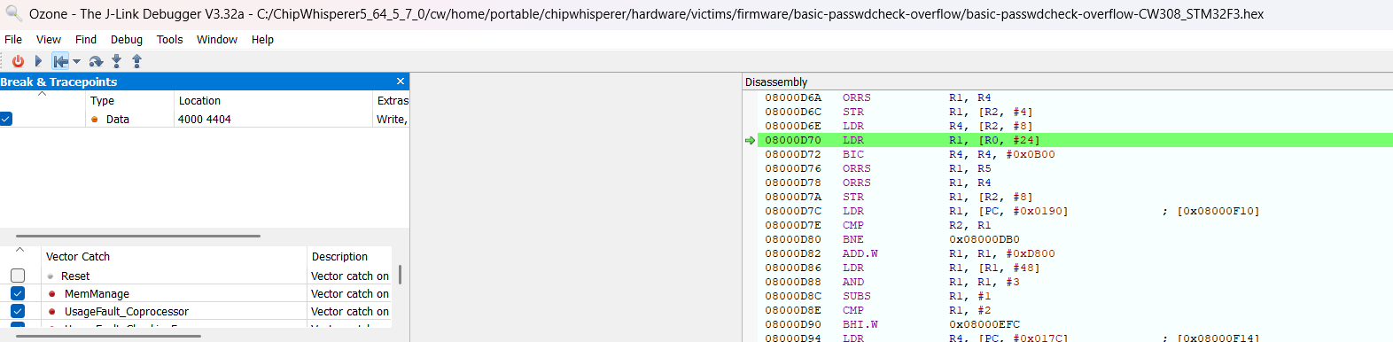
Running into Breakpoint

Slide 33
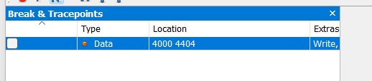
Enabling/Disabling Breakpoints
Uncheck the box to disable – handy when you don’t want it to trigger as only want it after something like your user input

Slide 34
Running Python Programs
Can run "raw" Python programs, but for evaluations interactive can be useful
We'll use this with ChipWhisperer on the final (4th) lab

Slide 35
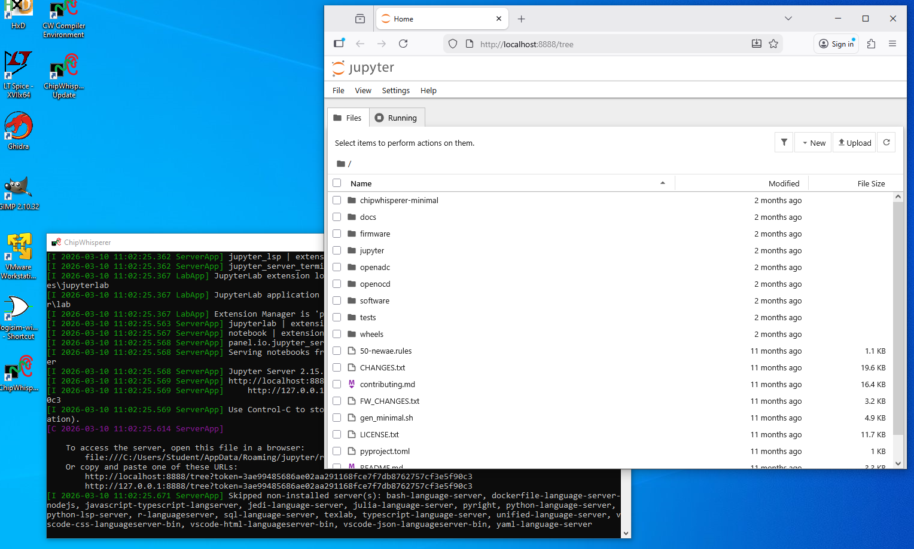
Python & ChipWhisperer

Slide 36
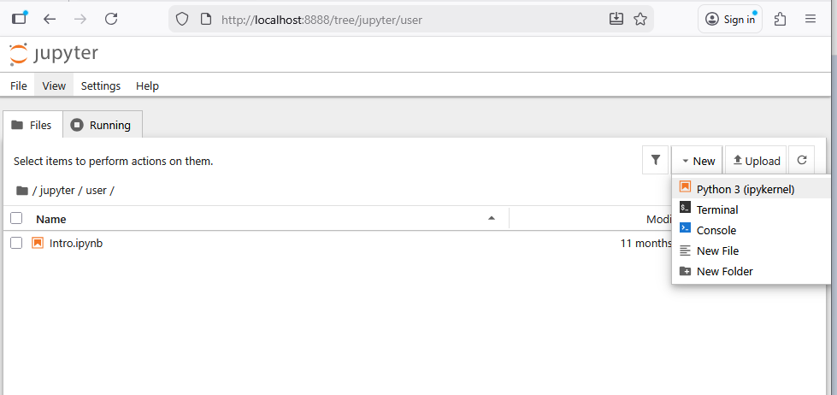
Python & ChipWhisperer

Slide 37
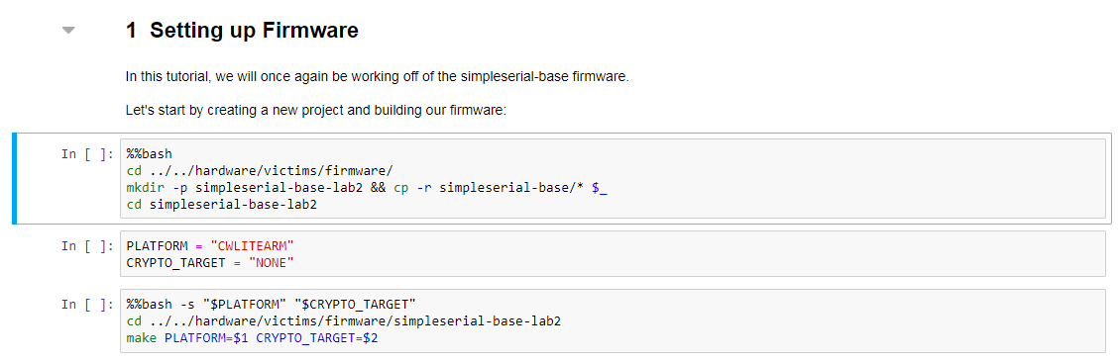
Running Jupyter Tutorials
Run highlighted block
Shift-Enter runs and moves to next.
Ctrl-Enter runs and stays on cell.

Slide 38
What is Jupyter?
Interactive Python 3! Many advantages:
Can move to “pure” Python easily afterwards.
During development, interactive nature makes discoveries easier.

Slide 39
Jupyter is not Perfect
Hidden state problems.
People don't ship notebooks with requirements.txt, etc.
No testing/linting that's any good built-in.
Very useless code completion (have to run the cell first, etc.).
Can't take advantage of type hints.
Several other things.

Slide 40
Lab #3 & Assignment #2
You will cover this in Lab #3 (groups allowed) + Assignment #2 (Individual)
In Lab #3 perform a buffer overflow and inspect the running hardware.
In Assignment #2 investigate buffer overflow prevention methods and related topics (to be completed individually).
You can choose to install Ozone on your computer or complete in the lab.

